Slide 1
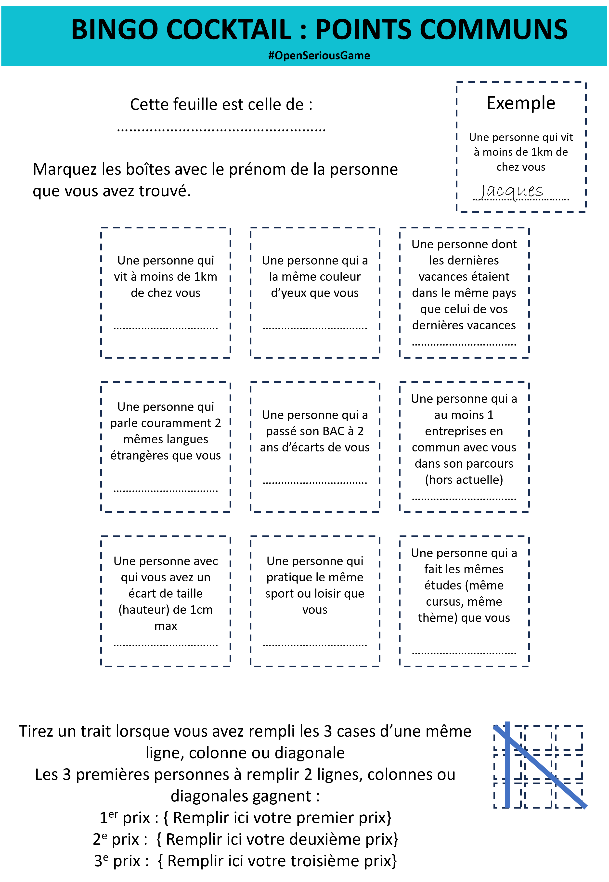





BINGO COCKTAIL V2 A pretext for discussion and getting to know others. 10-20 minutes. Can be played during a buffet. Unlimited number of people.
Someone who lives in a town next to yours
Someone who got his high school diploma no more than 2 years apart from you.
To invite you to discover and/or discuss within your collective
Distribute these sheets to your participants, let people meet by looking to check boxes. The first winners receive a mini-prize
Ideal during free moments: Breaks, cocktails, etc. or in "free flow" during an event day

Slide 2
BINGO COCKTAIL : PERSONAL SIMILARITIES #OpenSeriousGame
This is the bingo sheet of (write down your name) ……………………………………………
Mark the boxes with the first name of the person you find.
Example A person who lives less than 1km from your home ..................................
Jacques
A person who lives less than 1km from your home .................................
A person who has the same eye color as you .................................
A person whose last holiday was in the same country as your last holiday .................................
A person who is fluent in 2 same foreign languages that you also speak .................................
A person who has passed his high-school diploma at 2 years of maximum apart from you .................................
A person who has at least 1 company in common with you in their curriculum (excluding current) .................................
A person with whom you have a height gap of 1cm max .................................
A person who practices the same sport or hobby as you .................................
A person who has done the same studies (same curriculum, same theme) as you did .................................
Draw a line when you have filled all 3 boxes in the same row, column or diagonal The first 3 people to fill in 2 rows, columns or diagonals win: 1st prize: { Fill in your first prize here} 2nd prize: { Fill in your second prize here} 3rd prize: { Fill in your third prize here}

Slide 3
BINGO COCKTAIL : PERSONAL SIMILARITIES #OpenSeriousGame
This is the bingo sheet of (write down your name) ……………………………………………
Mark the boxes with the first name of the person you find.
Example A person who lives less than 1km from your home ..................................
Jacques
A person who wears socks of the same color as you ..................................
A person who takes the same time to go to work (5 minutes difference max) ..................................
A person who had the same position as you in the past (not necessarily at the same time) ..................................
A person who has as many children as you do (zero is also possible) ..................................
A person whose favorite series/movie is the same as yours ..................................
A person who has a car of the same brand as yours ..................................
A person who was born less than 5km from where you were born ...............................
A person who has the same haircut as you (roughly) ................................
A person whose first name begins with the same letter as yours ...............................
Draw a line when you have filled all 3 boxes in the same row, column or diagonal The first 3 people to fill in 2 rows, columns or diagonals win: 1st prize: { Fill in your first prize here} 2nd prize: { Fill in your second prize here} 3rd prize: { Fill in your third prize here}

Slide 4
BINGO COCKTAIL : PROFESSIONAL SIMILARITIES #OpenSeriousGame
This is the bingo sheet of (write down your name) ……………………………………………
Mark the boxes with the first name of the person you find.
Example A person who lives less than 1km from your home ..................................
Jacques
A person who has at least one same professional certification as yours .................................
A person who works in the same technology field as yours .................................
A person who arrives at the office at the same time as you (5 minutes difference max) .................................
A person who had a manager in common with you but not as a same time .................................
A person who studies the same professional topics as you (during personal time) .................................
A person whose team is the same size as yours (1 person different max) .................................
A person who roughly has the same number of years of experience in the company as you (1 year difference max) ...............................
A person who roughly has the same number of years of professional experience as you (2 years difference max) ...............................
A person who works with at least 4 people in common with you ...............................
Draw a line when you have filled all 3 boxes in the same row, column or diagonal The first 3 people to fill in 2 rows, columns or diagonals win: 1st prize: { Fill in your first prize here} 2nd prize: { Fill in your second prize here} 3rd prize: { Fill in your third prize here}

Slide 5
BINGO COCKTAIL : EVENT CHARACTERISTICS #OpenSeriousGame
This is the bingo sheet of (write down your name) ……………………………………………
Mark the boxes with the first name of the person you find.
Example A person who lives less than 1km from your home ..................................
Jacques
The first person to arrive at today's event ..................................
Someone who can give you at least 10 first names of other participants (being right in the names) ..................................
Someone who is recognized for their mastery in the theme of the event ..................................
A person you meet for the first time today ..................................
Someone who introduced you to 2 other people (in detail, at least a few minutes per person) ..................................
Someone who poured themselves the same first drink as you, and the same second ..................................
A person who does a sports activity at least 4 hours a week ..................................
A person born at least 300 km from here. ..................................
The youngest person in the group ..................................
Draw a line when you have filled all 3 boxes in the same row, column or diagonal The first 3 people to fill in 2 rows, columns or diagonals win: 1st prize: { Fill in your first prize here} 2nd prize: { Fill in your second prize here} 3rd prize: { Fill in your third prize here}

Slide 6
BINGO COCKTAIL : PROFESSIONAL POINTS #OpenSeriousGame
This is the bingo sheet of
(write down your name below)
……………………………………………
Mark the boxes with the first name of the person you find (today in the event) that match the conditions.
Example A person who lives less than 1km from your home ..................................
Jacques
A person who has at least one same professional certification as yours .................................
A person who works in the same technology field as yours .................................
A person who arrives at the office at the same time as you (5 minutes difference max) .................................
A person who could mentor you in a topic you are currently learning .................................
A person who had a manager / senior manager / director in common with you but not as a same time .................................
A person who studies the same professional topics as you (during personal time) .................................
A person whose team is the same size as yours (1 person different max) .................................
A person who has the entered in his / her job the same month as you did (not necessarily the same year)
.................................
A person who roughly has the same number of years of experience in the company as you (1 year difference max) ...............................
A person who roughly has the same number of years of professional experience as you (2 years diff max) ...............................
A person who works with at least 3 people in common with you ...............................
A person you would hire in your team if it had the budget (justify why)
...............................
A person with whom you share a common professional objective
...............................
A person who knows at least 10 person in common with you
...............................
A person you would associate to if you were to host a meetup or be a speaker ...............................
A person who you could mentor in a topic he or she is currently learning ...............................
Draw a line when you have filled all 4 boxes in the same row, column or diagonal. 1st prize: { Fill in your first prize here} 2nd prize: { Fill in your second prize here} 3rd prize: { Fill in your third prize here}

Slide 7
BINGO COCKTAIL Facilitator's Guide #OpenSeriousGame
Objective Team building game The objective of this mini-game is to start the discussion between the members of a collective, giving a pretext to meet and get to know each other. Everyone is free to play or not, free to share details or not. | Audience and ideal context This presentation mini-game fits well to moments of break for a large collective (>30 people) whose members do not all know each other, or do not have the opportunity to interact daily. Example: - Members of the same multi-team program - Members of the same department - Participants in the same meetup Context of use: - Can be used in gamification of a cocktail moment - Can be used in "free to play" over a day of corporate event - As part of a more serious event, to create an informal link
Beforehand Review the cocktail bingo tables and adjust the boxes if necessary. You can mix professional and personal questions, create your own boxes, etc. (Optional) Prepare gifts for when participants have successfully completed a line. Examples: Chocolate, books, concert ticket, etc. Find whatever fits the theme of your event Fill in the prices in the sheets before printing. You can print sheets of multiple templates if you want. Print the sheets (A4 or A5) . | Animation and tips Hand out bingos with a pen at the beginning of the event Tip: You can distribute different sheets (Optional) You can remove the reward part and leave the game free or add a rule of limited time.
#OpenSeriousGame Creator's Guide
Principles used in this game "Gamified" meeting (pretext game) Trying to fill the sheet break the ice | Game variants See the different sheets….
Version creator Alexandre QUACH, KOMYU | Reuse License Creative Commons Attribution 3.0 https://creativecommons.org/licenses/by/3.0/

